Slide 1

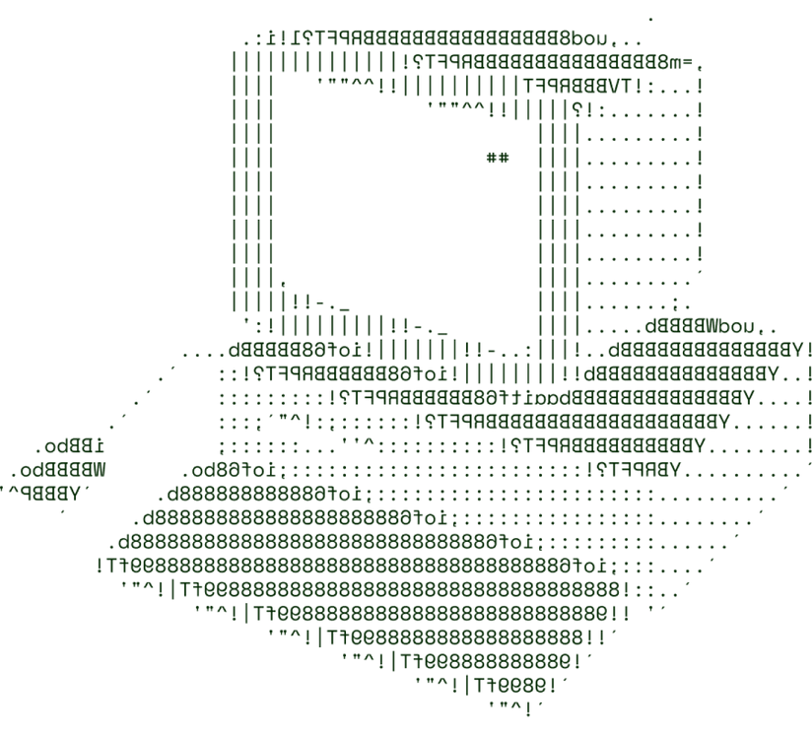
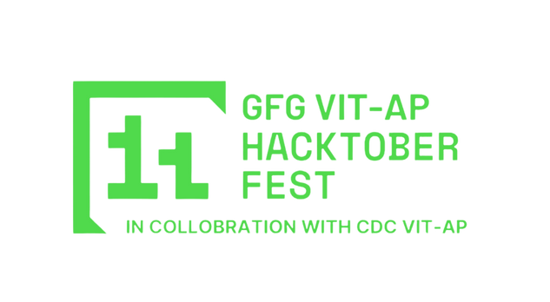

Image Insight
AUTOMATED FEATURE EXTRACTION FOR PRODUCT INFORMATION
TEAM NAME: TECHNOLOGY LOVERS
TEAM NO: 15

Slide 2

PROBLEM STATEMENT
As digital marketplaces expand, many products lack detailed textual descriptions,making it essential to obtain key details directly from images. These images provide important information such as weight, volume, voltage, wattage, dimensions,and many more, which are critical for digital stores.
The goal is to create a machine learning model that extracts entity values from images. This capability is crucial in fields like healthcare,
e-commerce, and content moderation, where precise product information is vital.

Slide 3
SOLUTION OVERVIEW
Brief Description:
Our solution is an AI-driven product attribute extraction tool that reads and interprets key specifications (like weight, volume, and dimensions) from product images, specifically designed for e-commerce applications.
How it addresses the problem
It automates data extraction from images, reducing reliance on manual entry and ensuring accurate product information when textual descriptions are missing.

Slide 4
SOLUTION OVERVIEW
Innovation and uniqueness of the solution
Leverages computer vision and natural language processing (NLP) to extract entity values directly from images.
Combines image recognition with OCR (Optical Character Recognition) to identify text and measurement units present on product labels or packaging
key features and benefits
Automation: Eliminates the need for manual product data entry.
Accuracy: Provides precise and reliable extraction of critical product details.
Multimodal Analysis: Supports multiple image types and resolutions, and extracts both textual and non-textual entity values.

Slide 5

CRNN (Convolutional Recurrent Neural Network):
Deep Learning-based Methods:
1.Text Detection Model: YOLOv8 (You Only Look Once v8)
2.Character Recognition Model: CRNN (Convolutional Recurrent Neural Network)
Combining the Two
Frontend
React.js, Bootstrap/Tailwind CSS
Backend
TECHNICAL ARCHITECTURE
Flask (Python), TensorFlow/Keras for AI models, OpenCV & Tesseract OCR for image/text processing
Database
MongoDB for unstructured data, PostgreSQL for structured querie

Slide 6
SCALABILITY AND FUTURE SCOPE
Handling Increased Load:
The system will be hosted on cloud platforms (AWS/GCP), enabling elastic scalability to handle increased image processing loads.
We implement Auto-scaling mechanisms that monitor traffic and dynamically adjust computing resources based on demand.
Future Scope:
Multilingual OCR Support: Expand the system to support text extraction in multiple languages, allowing it to be used in global markets.
3D Object Recognition: Add functionality to detect 3D object properties like curvature, volume, and surface area.
Integration with AR/VR: Explore AR/VR technologies to visually overlay extracted product data on the images for e-commerce and healthcare purposes.

Slide 7
FEASIBILITY
Data Quality: Variations in image resolution and quality may affect the accuracy of feature extraction.
Complex Product Variations: Handling complex, multidimensional products that require precise measurements and contextual understanding.
Scalability Under Heavy Traffic: Ensuring that the system performs efficiently under high volumes of image uploads.
Strategies to Overcome These Challenges:
Preprocessing Pipeline: Implement image preprocessing techniques like denoising, resizing, and contrast adjustment to enhance image quality before extraction.
Custom Model Fine-Tuning: Fine-tune models specifically for complex product types
or industries (e.g., pharmaceuticals, heavy machinery).

Slide 8

>Team Details

Slide 9




G.Kalyan Ram
N.V.Sriraj
22BCE8814
22BCE9276
G.Sai Shivananda
CH.Abhiram
22BCE7263
22BCE8988

Slide 10

Thanks for Joining

